Slide 1
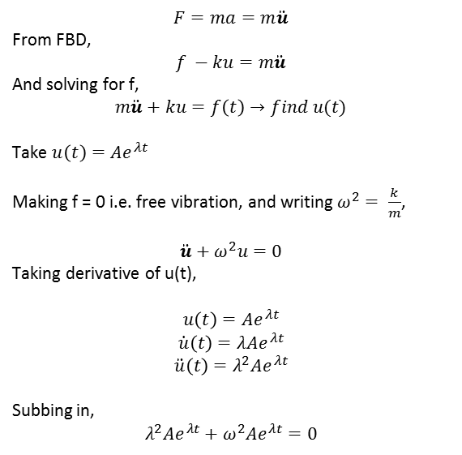
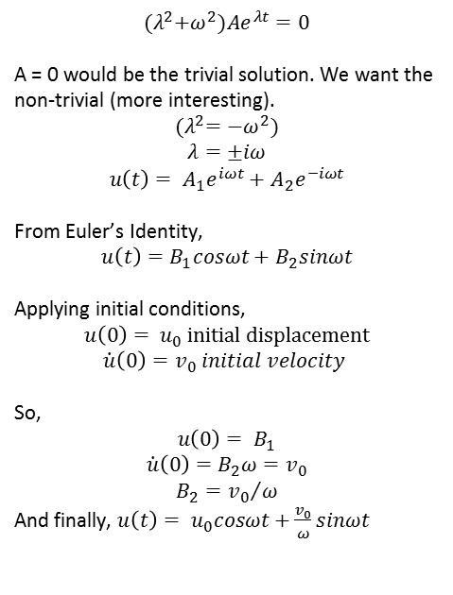
SDOF Oscillator (no damping)
$$F=ma=m\ddot{u}$$
From FBD,
$$f −ku=m\ddot{u}$$
And solving for f,
$$m\ddot{u}+ku=f\left(t\right)→find u(t)$$
Take $u\left(t\right)=Ae^{λt}$
Making f = 0 i.e. free vibration, and writing $ω^{2}= \frac{k}{m}$,
$$\ddot{u}+ω^{2}u=0$$
Taking derivative of u(t),
$$u\left(t\right)=Ae^{λt}$$
$$\dot{u}\left(t\right)=λAe^{λt}$$
$$\ddot{u}\left(t\right)=λ^{2}Ae^{λt}$$
Subbing in,
$$λ^{2}Ae^{λt}+ω^{2}Ae^{λt}=0$$
$${(λ}^{2}+ω^{2})Ae^{λt}=0$$
A = 0 would be the trivial solution. We want the non-trivial (more interesting).
$${(λ}^{2}={−ω}^{2})$$
$$λ=±iω$$
$$u\left(t\right)= A_{1}e^{iωt}+A_{2}e^{−iωt}$$
From Euler’s Identity,
$$u\left(t\right)=B_{1}cosωt+B_{2}sinωt$$
Applying initial conditions,
$$u\left(0\right)= u_{0} initial displacement$$
$$\dot{u}\left(0\right)=v_{0} initial velocity$$
So,
$$u\left(0\right)= B_{1}$$
$$\dot{u}\left(0\right)=B_{2}ω=v_{0}$$
$$B_{2}={v_{0}}/ω$$
And finally, $u\left(t\right)= u_{0}cosωt+\frac{v_{0}}{ω}sinωt$

Slide 2
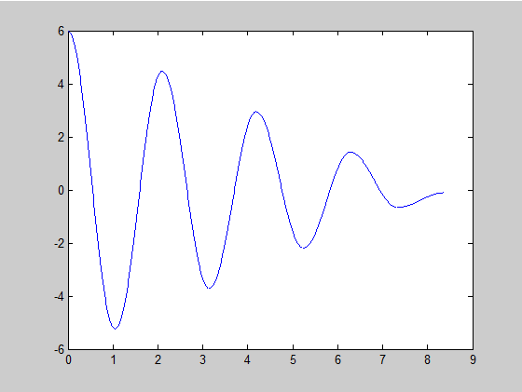



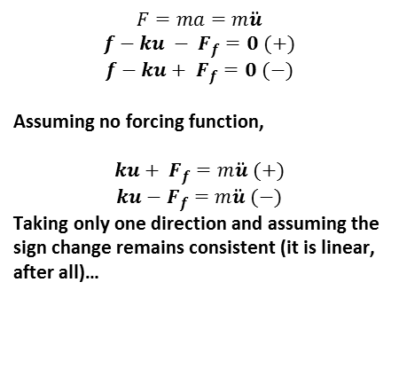


SDOF Oscillator (friction damping)
To solve for the equations of motion, we need to sum the forces…
$$f$$
$$F=ma=m\ddot{u}$$
$$f−ku − F_{f}=0 (+)$$
$$f−ku+ F_{f}=0 (−)$$
Assuming no forcing function,
$$ku+ F_{f}=m\ddot{u} (+)$$
$$ku−F_{f}=m\ddot{u} (−)$$
Taking only one direction and assuming the sign change remains consistent (it is linear, after all)…
$$W$$
$$F_{k}$$
$$f$$
$$N$$
$$F_{f}$$

Slide 3
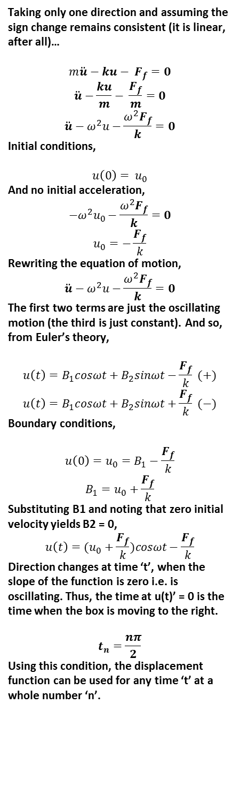
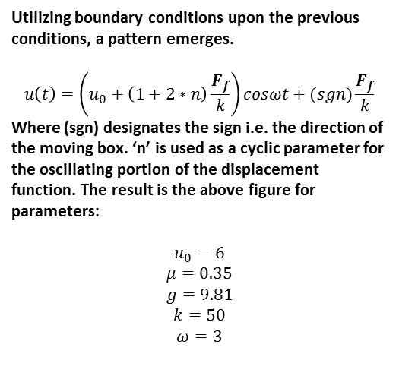
Taking only one direction and assuming the sign change remains consistent (it is linear, after all)…
$$m\ddot{u}−ku− F_{f}=0$$
$$\ddot{u}−\frac{ku}{m}− \frac{F_{f}}{m}=0$$
$$\ddot{u}−ω^{2}u−\frac{ω^{2}F_{f}}{k}=0$$
Initial conditions,
$$u\left(0\right)= u_{0}$$
And no initial acceleration,
$$−ω^{2}u_{0}−\frac{ω^{2}F_{f}}{k}=0$$
$$u_{0}=−\frac{F_{f}}{k}$$
Rewriting the equation of motion,
$$\ddot{u}−ω^{2}u−\frac{ω^{2}F_{f}}{k}=0$$
The first two terms are just the oscillating motion (the third is just constant). And so, from Euler’s theory,
$$u\left(t\right)=B_{1}cosωt+B_{2}sinωt−\frac{F_{f}}{k} (+)$$
$$u\left(t\right)=B_{1}cosωt+B_{2}sinωt+\frac{F_{f}}{k} (−)$$
Boundary conditions,
$$u\left(0\right)=u_{0}=B_{1}−\frac{F_{f}}{k}$$
$$B_{1}=u_{0}+\frac{F_{f}}{k}$$
Substituting B1 and noting that zero initial velocity yields B2 = 0,
$$u\left(t\right)=(u_{0}+\frac{F_{f}}{k})cosωt−\frac{F_{f}}{k}$$
Direction changes at time ‘t’, when the slope of the function is zero i.e. is oscillating. Thus, the time at u(t)’ = 0 is the time when the box is moving to the right.
$$t_{n}=\frac{nπ}{2}$$
Using this condition, the displacement function can be used for any time ‘t’ at a whole number ‘n’.
Utilizing boundary conditions upon the previous conditions, a pattern emerges.
$$u\left(t\right)=\left(u_{0}+\left(1+2∗n\right)\frac{F_{f}}{k}\right)cosωt+(sgn)\frac{F_{f}}{k}$$
Where (sgn) designates the sign i.e. the direction of the moving box. ‘n’ is used as a cyclic parameter for the oscillating portion of the displacement function. The result is the above figure for parameters:
$$u_{0}=6$$
$$μ=0.35$$
$$g=9.81$$
$$k=50$$
$$ω=3$$

Slide 4
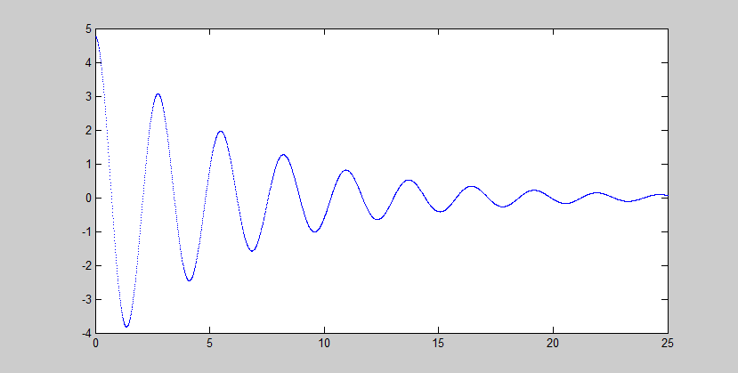
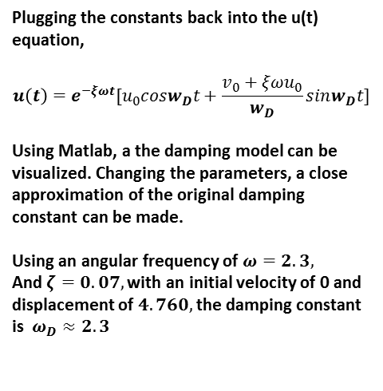
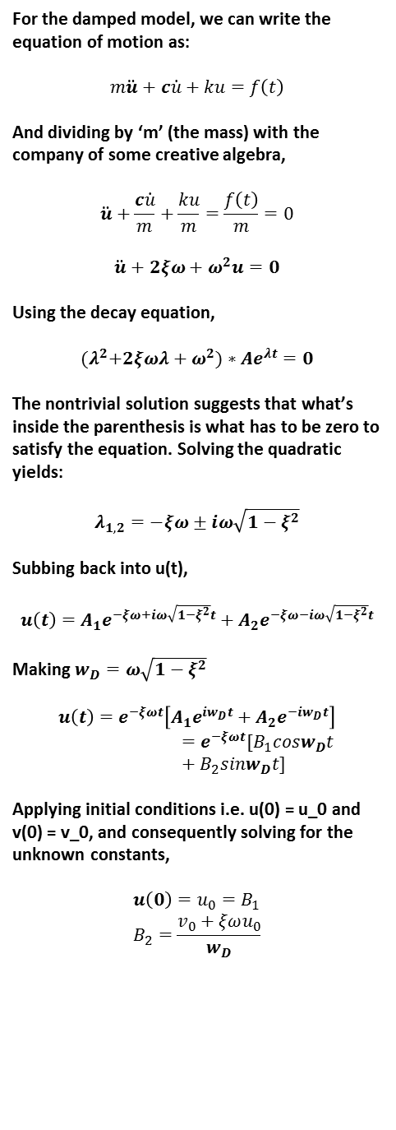
Determining the Damping Constant
For the damped model, we can write the equation of motion as:
$$m\ddot{u}+c\dot{u}+ku=f\left(t\right)$$
And dividing by ‘m’ (the mass) with the company of some creative algebra,
$$\ddot{u}+\frac{c\dot{u}}{m}+\frac{ku}{m}=\frac{f\left(t\right)}{m}=0$$
$$\ddot{u}+2ξω+ω^{2}u=0$$
Using the decay equation,
$${(λ}^{2}+2ξωλ+ω^{2})∗Ae^{λt}=0$$
The nontrivial solution suggests that what’s inside the parenthesis is what has to be zero to satisfy the equation. Solving the quadratic yields:
$$λ_{1,2}=−ξω±iω\sqrt{1−ξ^{2}}$$
Subbing back into u(t),
$$u\left(t\right)=A_{1}e^{−ξω+iω\sqrt{1−ξ^{2}}t}+A_{2}e^{−ξω−iω\sqrt{1−ξ^{2}}t}$$
Making $w_{D}=ω\sqrt{1−ξ^{2}}$
$$u\left(t\right)=e^{−ξωt}\left[A_{1}e^{iw_{D}t}+A_{2}e^{−iw_{D}t}\right]=e^{−ξωt}[B_{1}cosw_{D}t+B_{2}sinw_{D}t]$$
Applying initial conditions i.e. u(0) = u_0 and v(0) = v_0, and consequently solving for the unknown constants,
$$u\left(0\right)=u_{0}=B_{1}$$
$$B_{2}=\frac{v_{0}+ξωu_{0}}{w_{D}}$$
Plugging the constants back into the u(t) equation,
$$u\left(t\right)=e^{−ξωt}[u_{0}cosw_{D}t+\frac{v_{0}+ξωu_{0}}{w_{D}}sinw_{D}t]$$
Using Matlab, a the damping model can be visualized. Changing the parameters, a close approximation of the original damping constant can be made.
Using an angular frequency of $ω=2.3,$
And $ζ=0.07,$with an initial velocity of 0 and displacement of $4.760,$the damping constant is $ω_{D}≈2.3$

